Slide 1
Deep Joint Rain Detection and Removal from a Single Image
Wenhan Yang1, Robby T. Tan2,3, Jiashi Feng2, Jiaying Liu1, Zongming Guo1∗, and Shuicheng Yan4,2
Notes:
第一页

Slide 2
Abstract
We add a binary map that provides rain streak locations to an existing model(rain streak layer and a background layer)。
we developed a fully convolutional network that jointly detect and remove rain.
we develop a multi-task deep learning architecture that learns the binary rain streak map, the appearance of rain streaks, and the clean background.
we introduced an recurrent rain detection and removal network that removes both rain accumulation and heavy rain.
Notes:
第二页

Slide 3
Introduction
region-dependent rain models use a rain-streak binary map(1 indicates rain steaks and 0 otherwise in every pixel)
In this network, the features are extracted and refined progressively by aggregating information from several parallel convolutions with different dilated factors
A multi-scale discriminator is proposed to leverage both local and global information to determine whether the corresponding de-rained image is real or fake.
introducing a recurrent rain detection and removal network to remove rain streak accumulation(fog or mist)

Slide 4
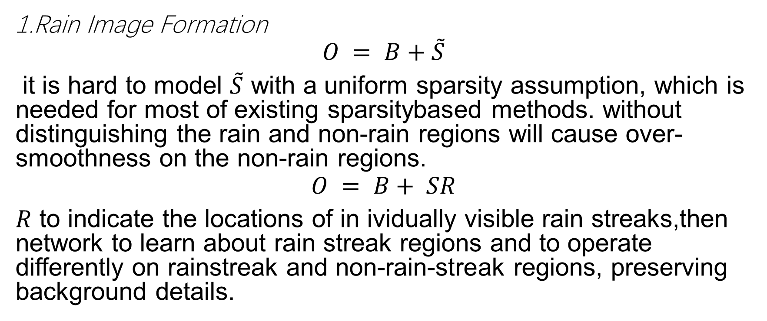
Region-Dependent Rain Image Model
1.Rain Image Formation
$$O = B+\tilde{S}$$
it is hard to model $\tilde{S}$ with a uniform sparsity assumption, which is needed for most of existing sparsitybased methods. without distinguishing the rain and non-rain regions will cause over-smoothness on the non-rain regions.
$$O = B+ SR$$
$R$ to indicate the locations of in ividually visible rain streaks,then network to learn about rain streak regions and to operate differently on rainstreak and non-rain-streak regions, preserving background details.

Slide 5

2. Rain Accumulation and Heavy Rain
$$O = α \left(B+ \sum_{t=1}^{s}{{\tilde{S}}_{t}}R\right)+ \left(1 − α\right)A$$
${\tilde{S}}_{t}$ represent rain streaks have the same direction，with$s$ kinds。

Slide 6
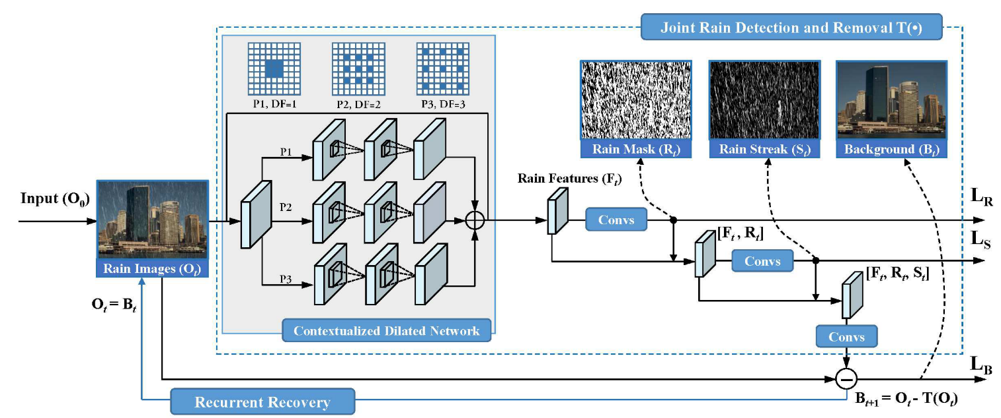

Slide 7
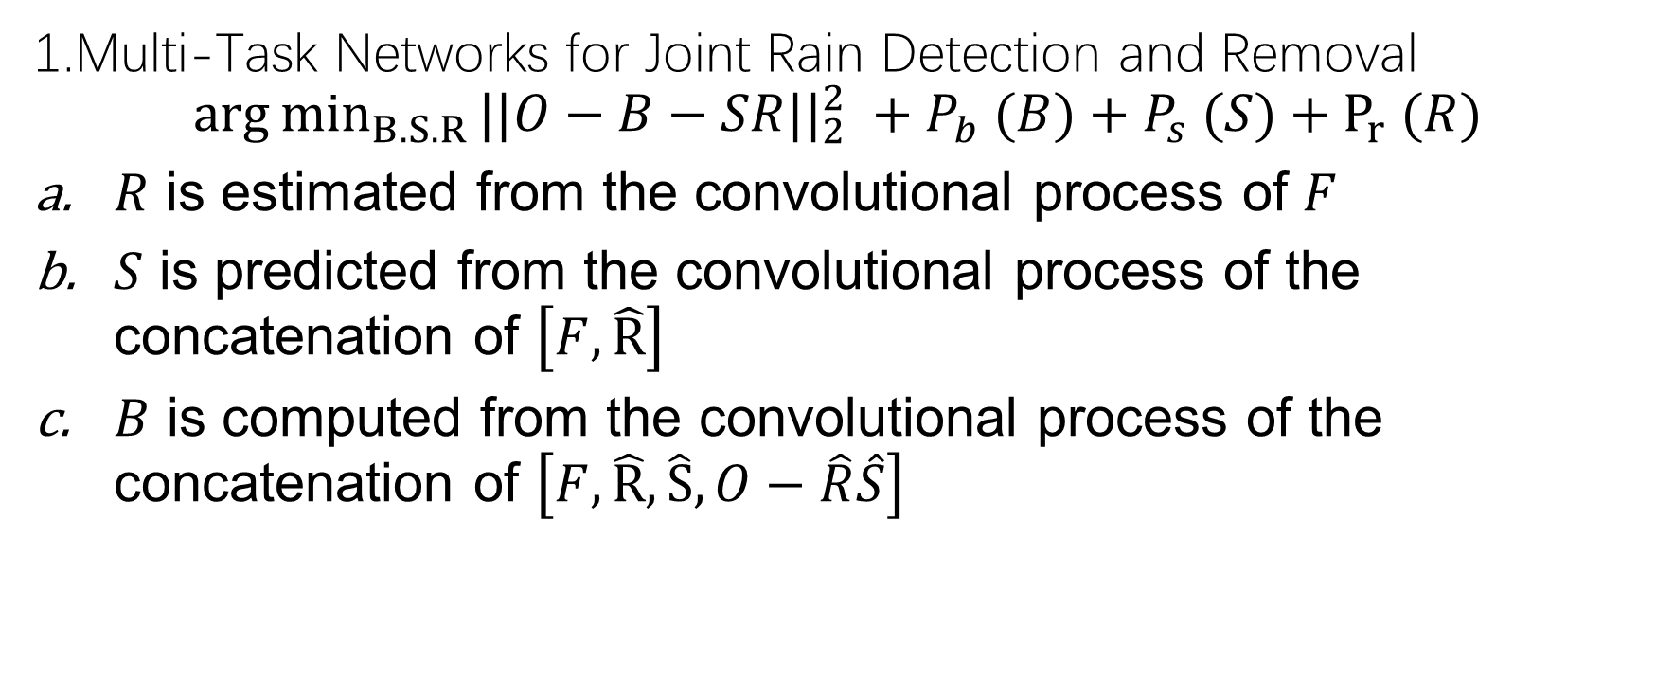
Joint Rain Streak Detection and Removal
1.Multi-Task Networks for Joint Rain Detection and Removal
$${arg⁡min}_{B.S.R}⁡{||O−B−SR||}_{2}^{2} +P_{b} (B)+P_{s} (S)+P_{r⁡} (R)$$
$R$ is estimated from the convolutional process of $F$
$S$ is predicted from the convolutional process of the concatenation of $\left[F, \hat{R}\right]$
$B$ is computed from the convolutional process of the concatenation of $\left[F, \hat{R}, \hat{S},O−\hat{R}\hat{S}\right]$

Slide 8

2. Contextualized Dilated Networks
$Through$ a recurrent structure provides an increasingly larger receptive field for the subsequent layer
in each recurrence, the output features aggregate the representations of the three convolution paths with different dilated factors and receptive fields

Slide 9
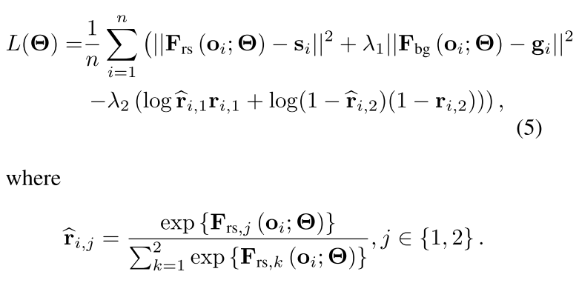
3. Network Training

Slide 10
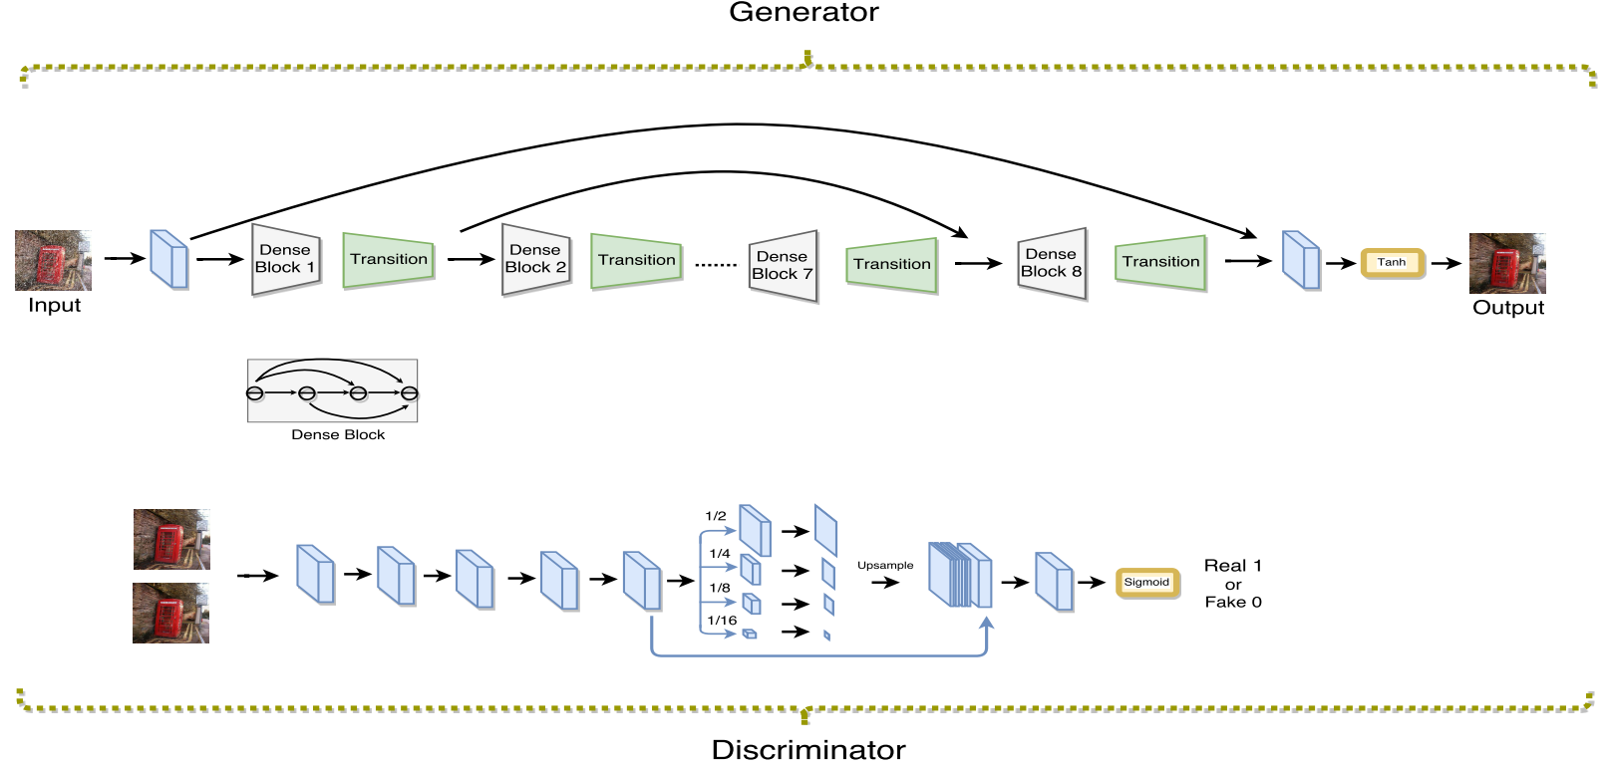
Proposed Method
ID-CGAN：generator, discriminator and perceptual loss function

Slide 11
A.GAN Objective Function
Given an input rainy image x, conditional GAN learns a non-linear function to synthesize the output image y by conditioning on the input image x.
B.Generator with symmetric structure
These dense blocks enable strong gradient flow and result in improved parameter efficiency.
we introduce skip connections across the dense blocks to efficiently leverage features from different levels and guarantee better convergence.
C. Multi-scale Discriminator
a multi-scale pooling module, which pools features at different scales, is stacked at the end of the discriminator.

Slide 12

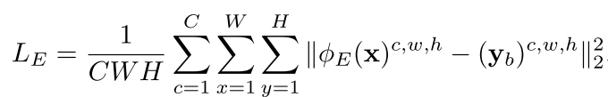
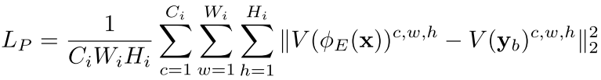
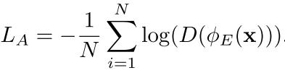
D. Refined Perceptual Loss
we combine pixel-to-pixel Euclidean loss, adversarial loss and perceptual loss together with appropriate weights to form our new refined loss function.

Slide 13
C.data
One picture with 14 different kinds，350 X 14 = 4900.
D.Combining CNN with image enhancement
Use non-linear function to enhance the base layer

